Slide 1
Creating Layouts in Dashboards

Slide 2
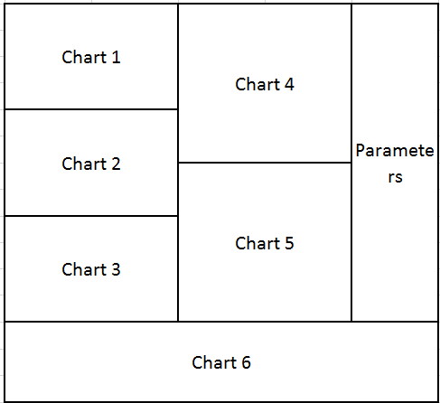
Say I want to create a dashboard that looks like this…
(Why you would want to do that, I don’t know)

Slide 3
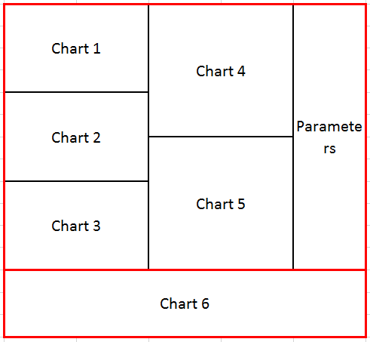
Determine if the top level container is vertical or horizontal
It is clear that this visualization can be broken into two different “sections” stacked on top of each other. This means that our outermost box must be a vertical box – the one which allows you to stack things on top of eachother. We’ll call this box V1

Slide 4
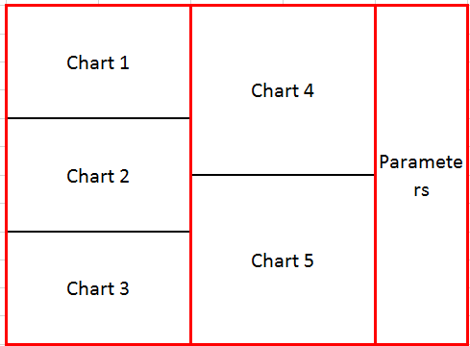
Look through each container to find sub-containers
Since chart 6 is the only thing in the bottom half of V1, we don’t need to do any further work on that. We can just place chart 6 inside V1.
The top half of V1 contains 3 columns of charts. This should tip you off that we need to add a horizontal container to the top half of the top level container. We’ll call this box H2.

Slide 5
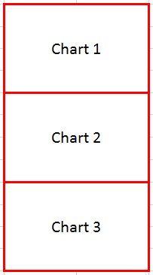
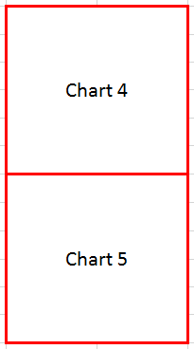
Look through each container to find sub-containers
Both the first and second columns of H2 consist of multiple charts stacked on top of each other. Again, that should tip you off that we need to add 2 vertical containers underneath H2. We’ll call these V31 and V32.
The last column contains only parameters, so we need only add the parameters directly H2.

Slide 6
Look through each container to find sub-containers
Since we have now successfully partitioned the entire layout into individual sub-tiles, we can create our hierarchy

Slide 7
The final layout
V1
H2
V31
Chart 1
Chart 2
Chart 3
V32
Chart 4
Chart 5
Parameters
Chart 6

Slide 8
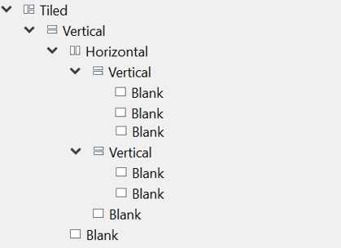
Creating it in Tableau
First, drag a “Vertical” container into the dashboard.
Drag a “Horizontal” container into the vertical container. A blue line should appear around the container you are dropping something into, which makes it easy to make sure you are dropping it into the correct place.
Drag chart 6 to the bottom of the page until you see a grey shadow appear on the bottom of the page, and a blue line appear around the vertical container. This means that you are placing the chart in the vertical container, but underneath your horizontal container.
Continue this process until you have added all of the elements
You can double check your work by checking to make sure the hierarchy under “Layout” looks the same as the one we developed.
Note that “Blank”s represent the charts in my example

